Slide 1
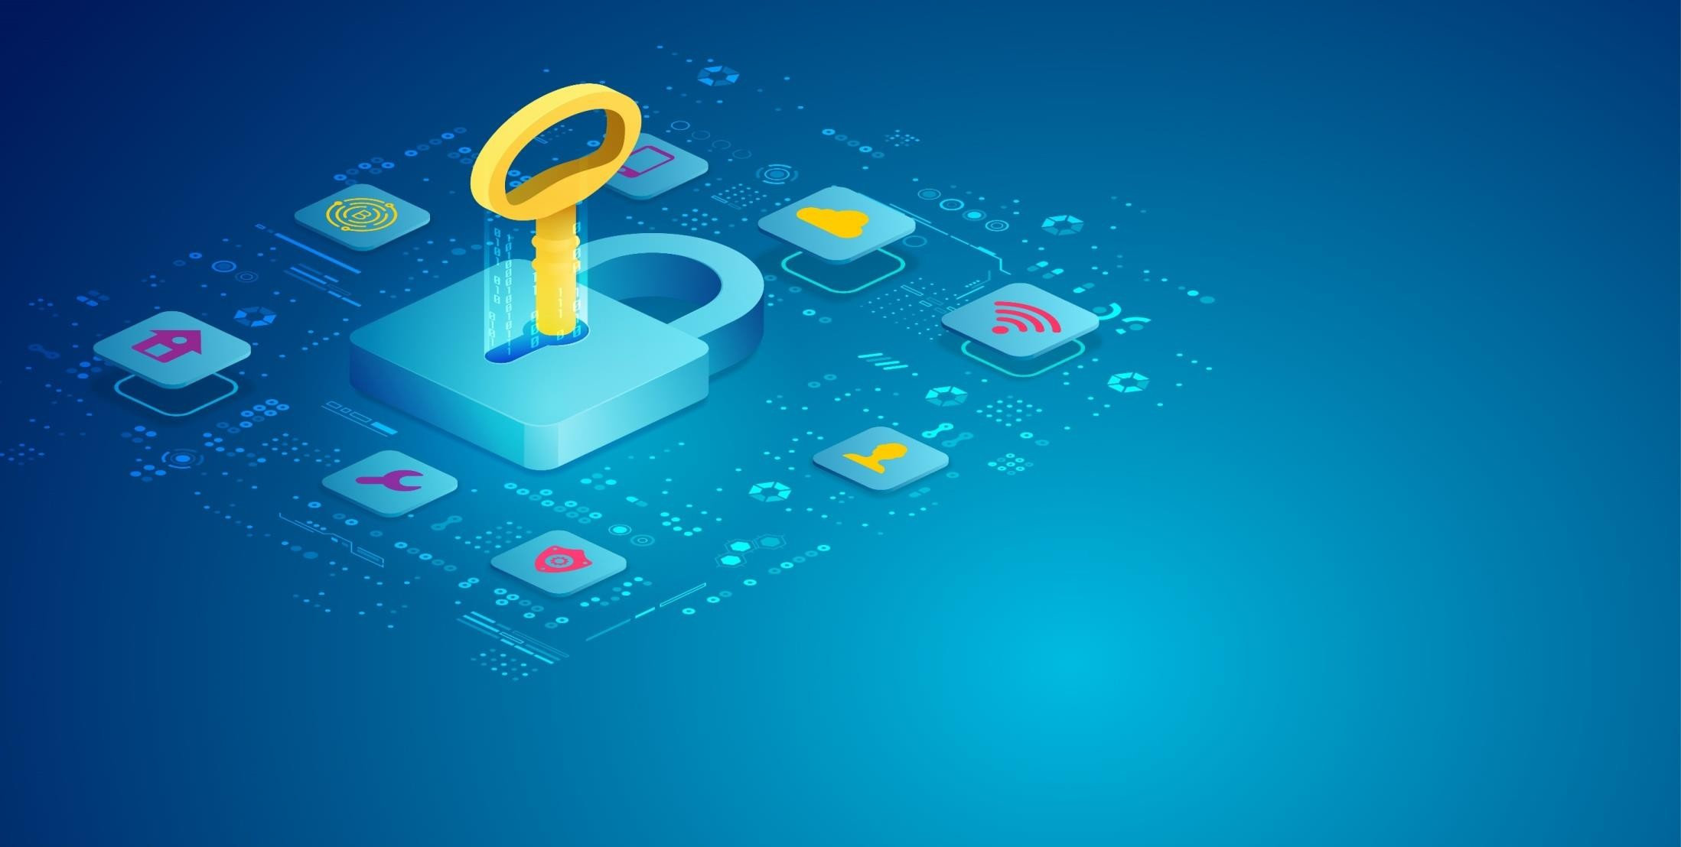

WE WELCOME YOU!
TRAINING & AWARENESS SESSION
on
ADVANCED CYBER THREATS
In
DIGITAL ERA

Slide 2
Chapter 1

Slide 3
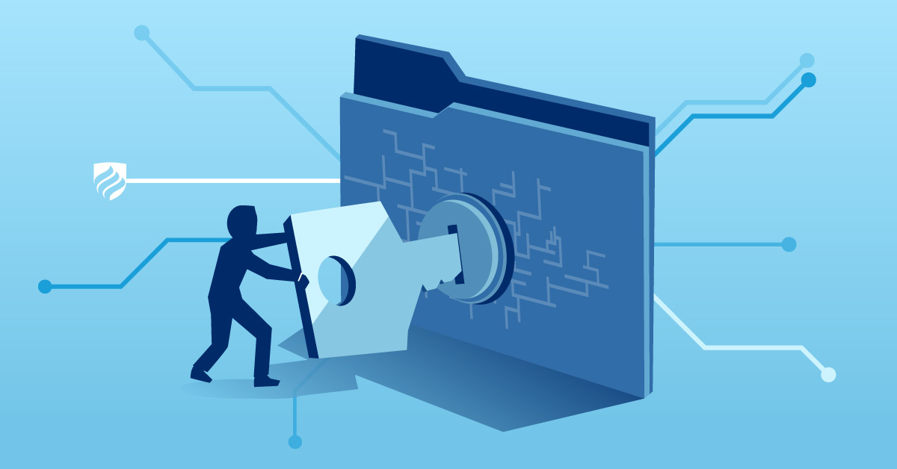
Information Security
“Information security” is a broad term that covers protection of data and the systems that contain it, from the storage location through all connections to it.
It includes the users who view, handle, and transmit it, and the devices they use to do so.
The first step to developing a comprehensive information security plan and a culture of cyber-security is to recognize the need to have such a plan.

Slide 4

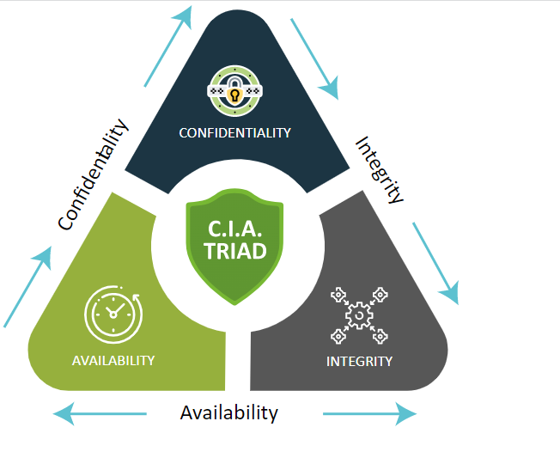
CIA Triad
Confidentiality: Data is kept private & secure, only to be accessed by specific parties.
Integrity: Data & the security around it is consistent, accurate & reliable.
Availability: System & applications remain available unless compromised in an attack.

Slide 5

Threat, Vulnerability & Risk
Threat
Threats have the potential to steal or damage data, disrupt business, or create harm in general.
In general terms, there are three categories.
Intentional threats: Things like malware, ransomware, phishing, malicious code, and wrongfully accessing user login credentials are all examples of intentional threats.
Unintentional threats: Unintentional threats are often attributed to human error.
Natural threats: While acts of nature (floods, hurricanes, tornadoes, earthquakes, etc.

Slide 6

Vulnerability
Vulnerability refers to a weakness in your hardware, software, or procedures.
It’s a gap through which a bad actor can gain access to your assets.
After exploiting a vulnerability, a cyberattack can run malicious code, install malware and even steal sensitive data.

Slide 7
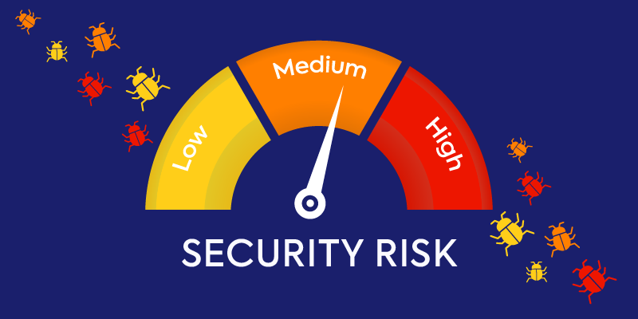
Risk
Cyber risk is the intersection of assets, threats, and vulnerabilities. It’s the potential for loss, damage, or destruction of an asset when a threat takes advantage of a vulnerability.
Threats + Vulnerability = Risk
To determine your level of cyber risk, you must understand the types of threats that are out there and know your system’s vulnerabilities.

Slide 8
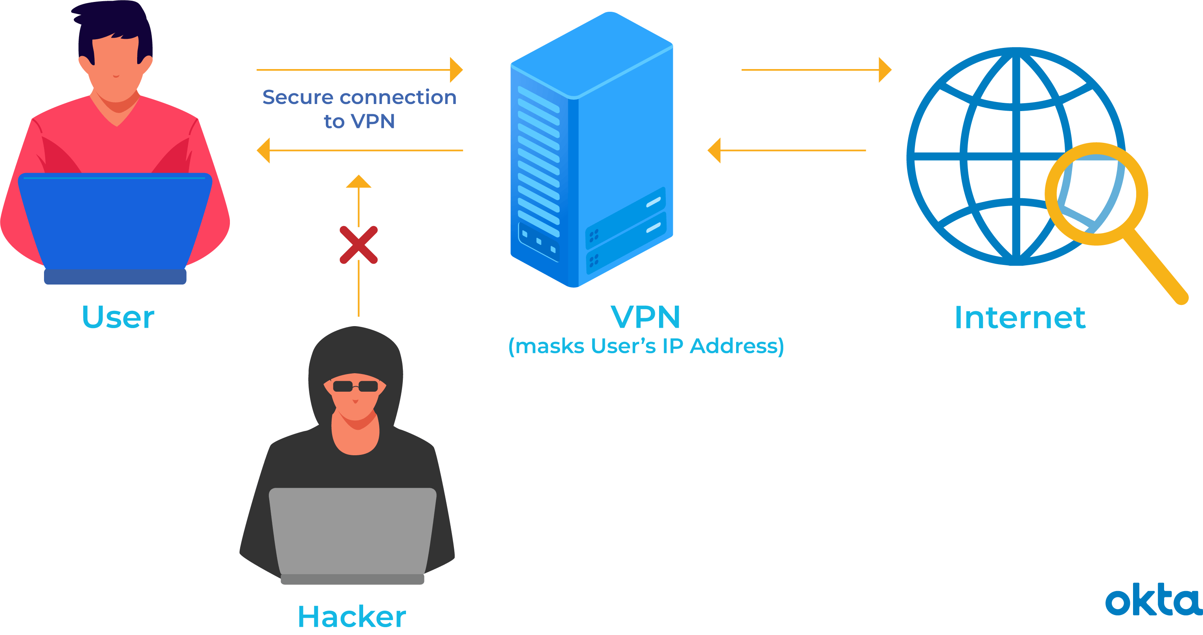
Protecting Our Network
User policies set on individual users.
Wireless security in public and private should be handled carefully.
Connections should only be made to known networks, and never free, password-less ones.
Wherever possible, employ secure connections such as Secure Shell (SSH) or Virtual Private Network (VPN).

Slide 9
Chapter 2

Slide 10
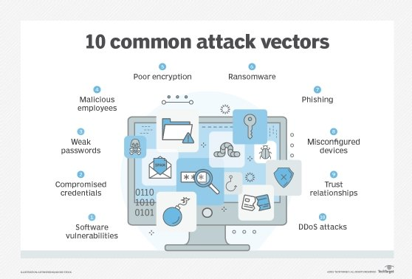
Attack Vectors
An attack vector is a path that a hacker takes to exploit cybersecurity vulnerabilities.
Common cyber attack vectors include viruses and malware, email attachments, webpages, pop-up windows, instant messages (IMs), chatrooms and deception.
Except for deception, all these methods involve programming or, in a few cases, hardware.
Deception is when a human operator is fooled into removing or weakening system defences.

Slide 11
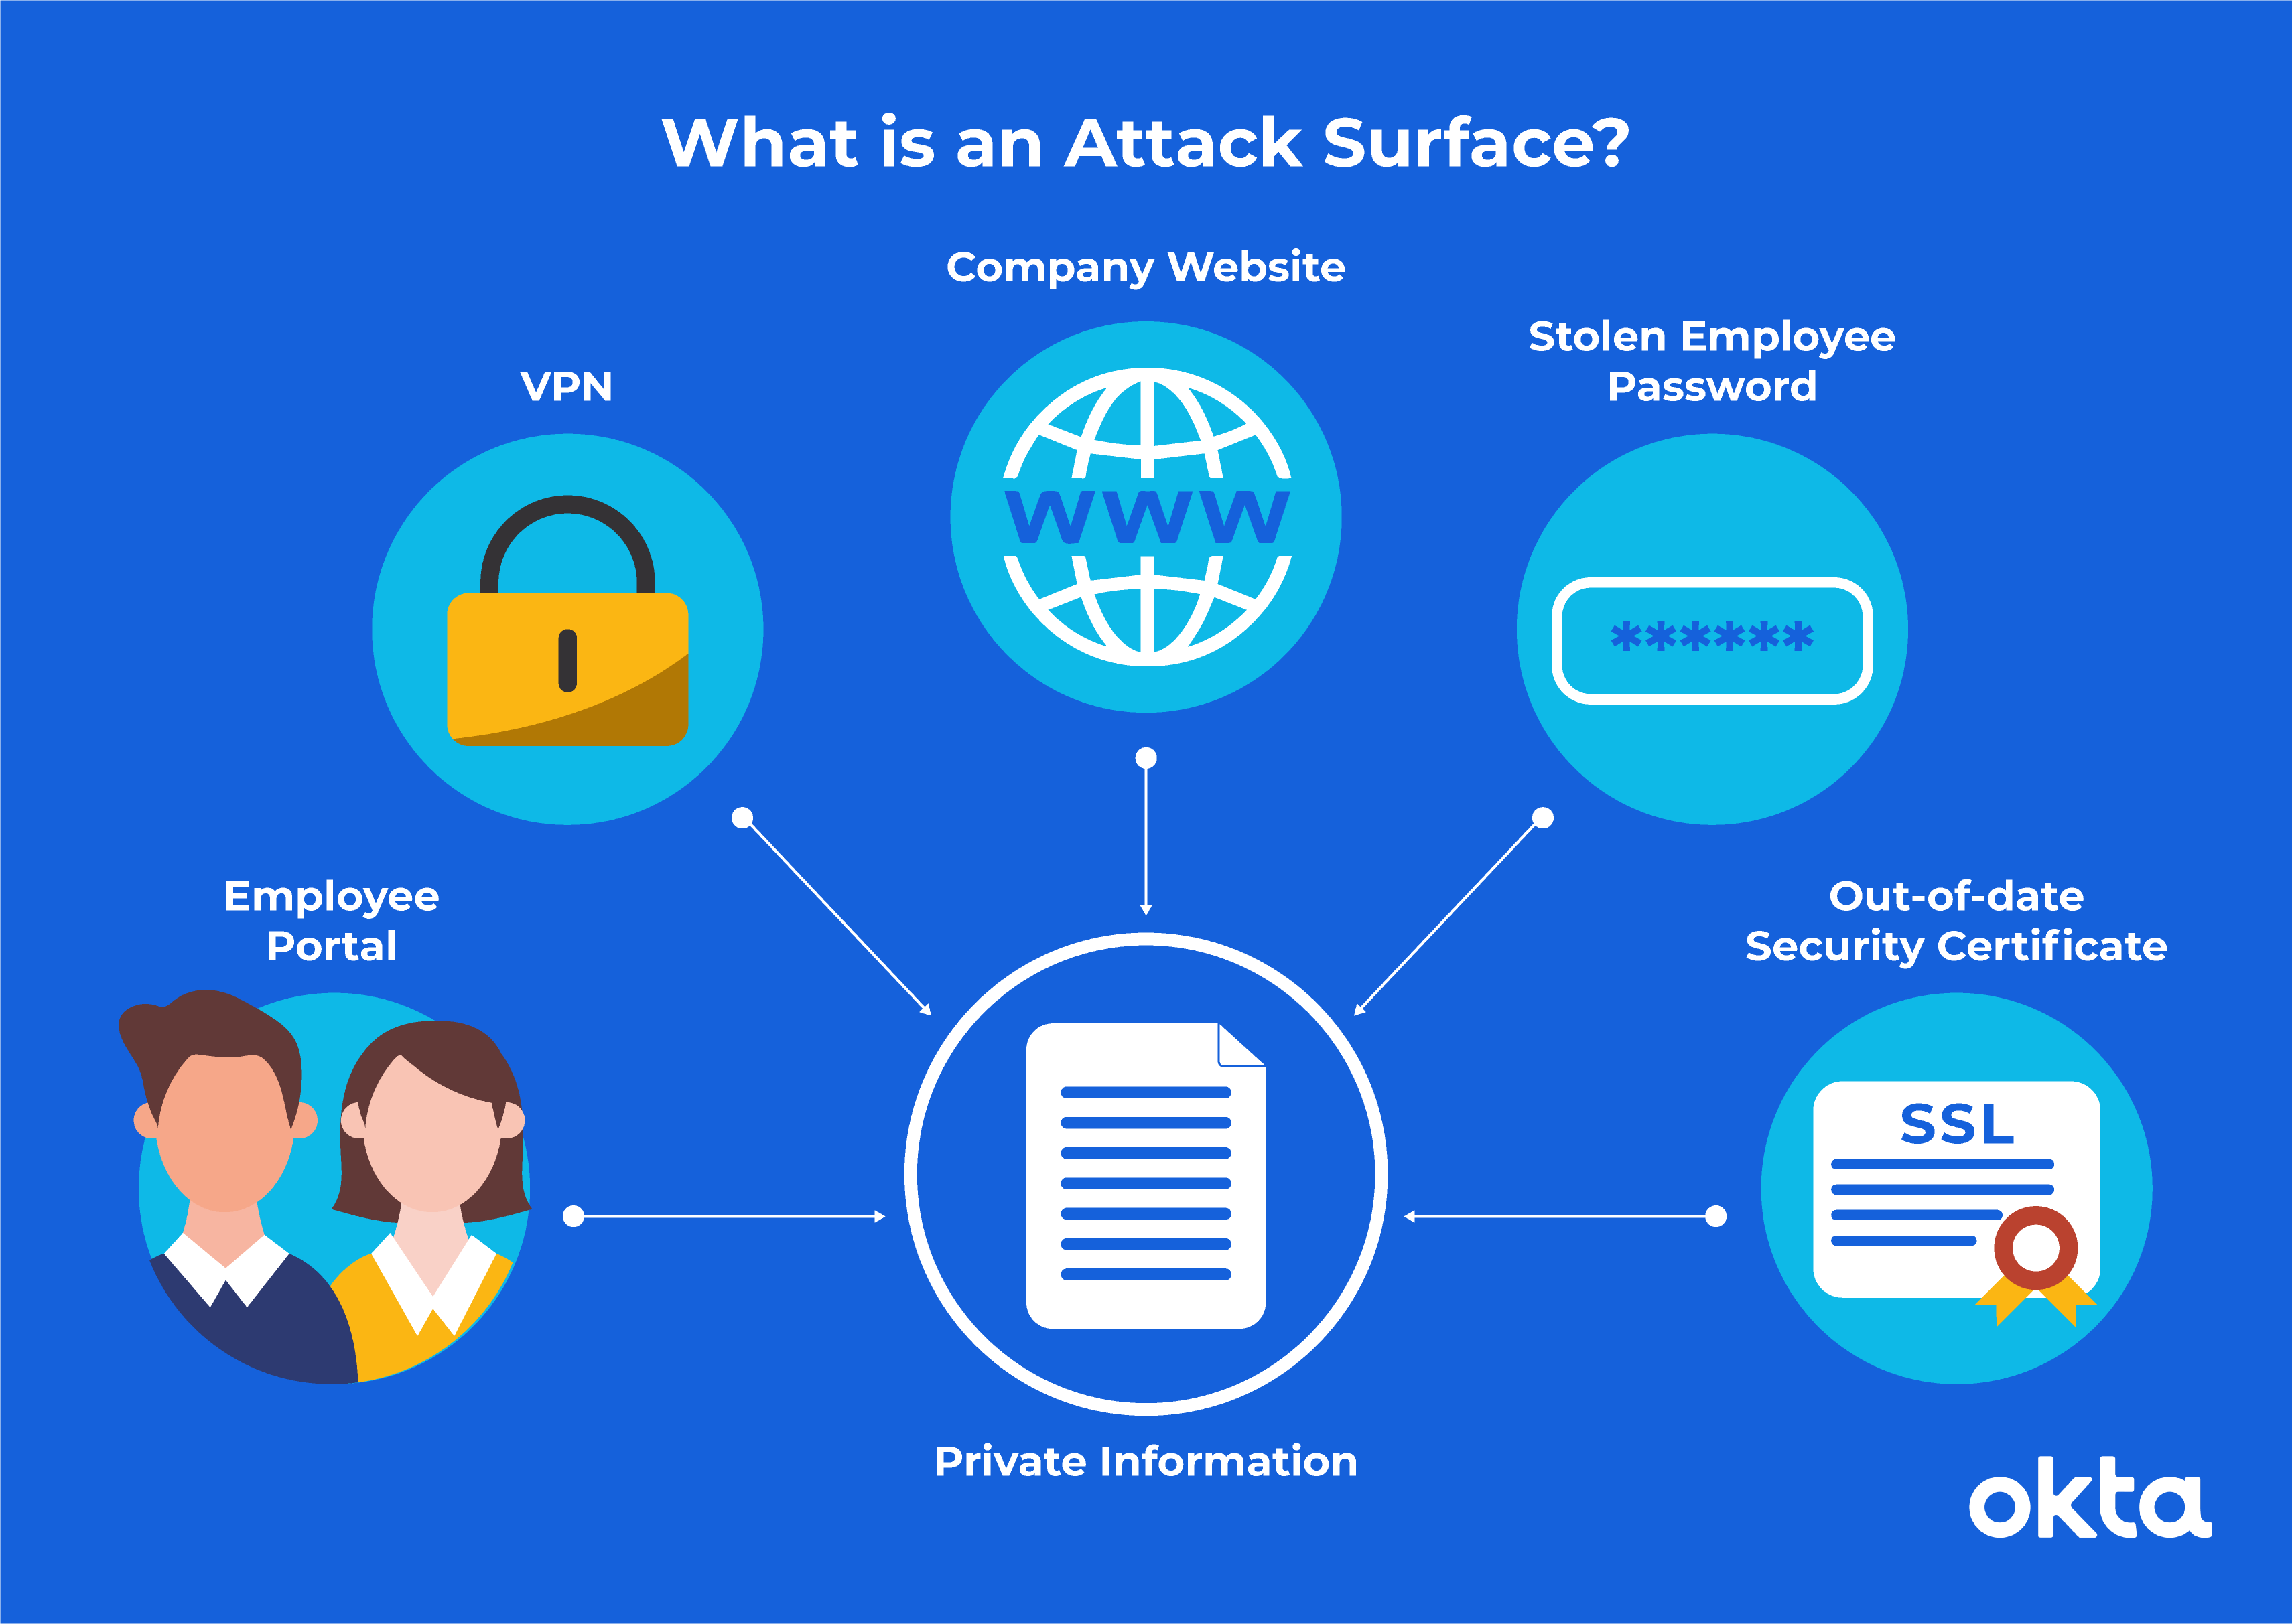
Attack Surfaces
An attack surface is defined as the total number of all possible entry points for unauthorized access into any system. It includes all vulnerabilities and endpoints that can be exploited to carry out a security attack.
The attack surface is also the entire area of an organization or system that is susceptible to hacking.
For most modern businesses, the attack surface is complex and massive.
The large number of devices, web applications and network nodes create many potential cybersecurity threats.

Slide 12
Types of attack surfaces
Digital attack surfaces encompass applications, code, ports, servers, and websites, as well as unauthorized system access points. Vulnerabilities left by poor coding, weak passwords, default operating system settings, exposed application programming interfaces or poorly maintained software are all part of the digital attack surface.
Physical attack surfaces comprise all endpoint devices, such as desktop systems, laptops, mobile devices, and USB ports. Improperly discarded hardware that may contain user data and login credentials, passwords on paper or physical break-ins are also included.

Slide 13
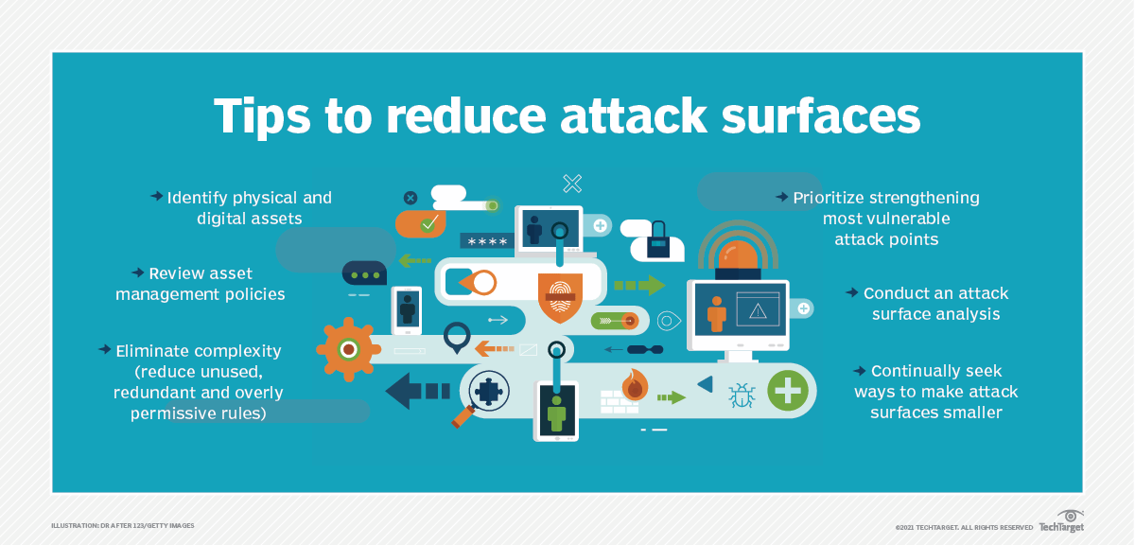
How can the attack surface be limited?
Organizations can have information security experts conduct attack surface analysis and management. Some ideas for attack surface reduction include the following:
Access control. Organizations should limit access to sensitive data and resources both internally and externally. Physical measures, like locking, access cards, biometric systems, and multifactor authentication (see video below), can be used.
Complexity elimination. Unnecessary or unused software can result in policy mistakes, enabling bad actors to exploit these endpoints. All system functionalities must be assessed and maintained regularly.
Regular scanning. Digital assets and data centers must be scanned regularly to spot potential vulnerabilities.
Network segmentation. Tools like firewalls and strategies like micro segmentation can be used to divide the network into smaller units.

Slide 14
Chapter 3

Slide 15
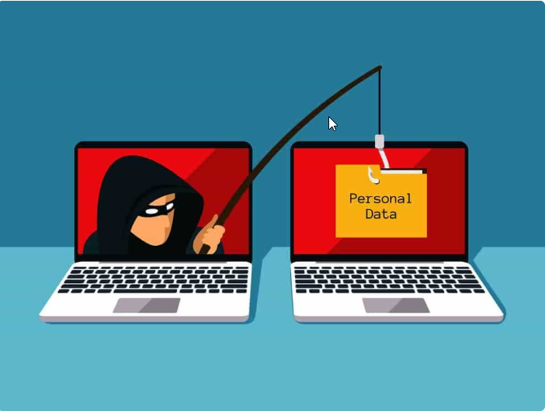
Phishing
Phishing is a type of social engineering where an attacker sends a fraudulent message designed to trick a person into revealing sensitive information to the attacker.

Slide 16
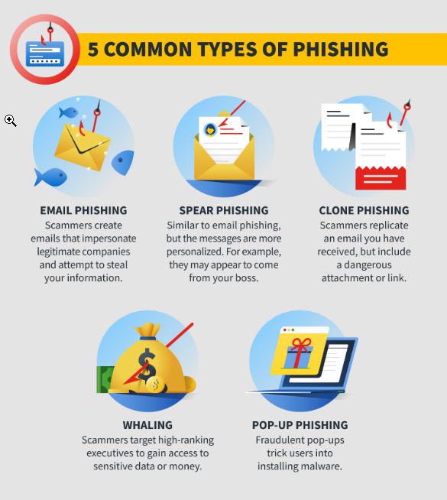
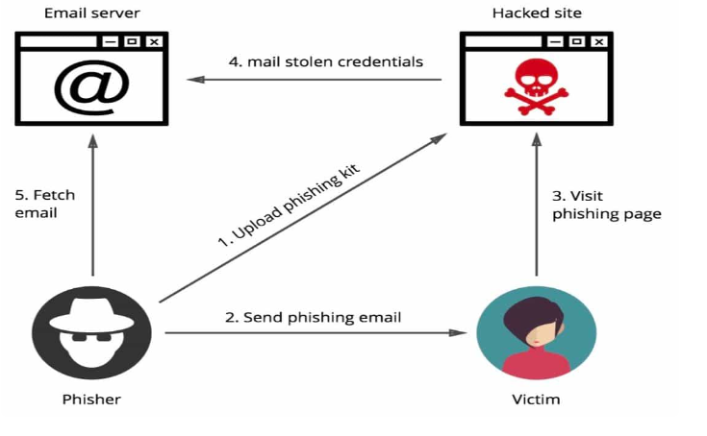
Phishing Cycle & Types

Slide 17
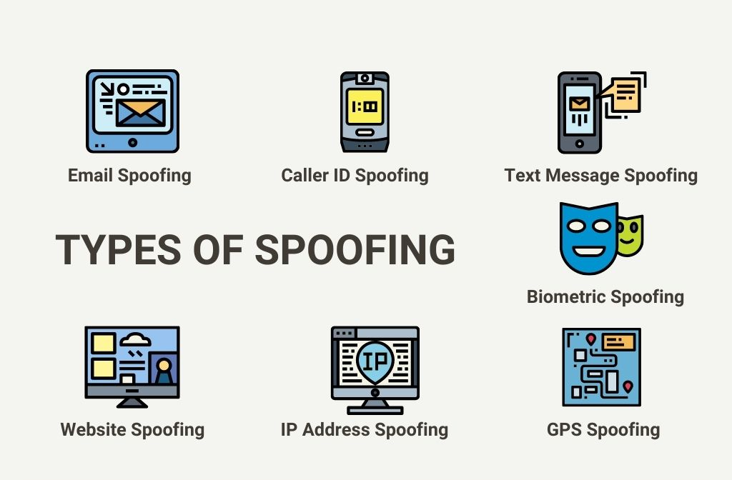
Spoofing and its types
In the context of information security, a spoofing attack is a situation in which a person or program successfully identifies as another by falsifying data, to gain an illegitimate advantage.

Slide 18
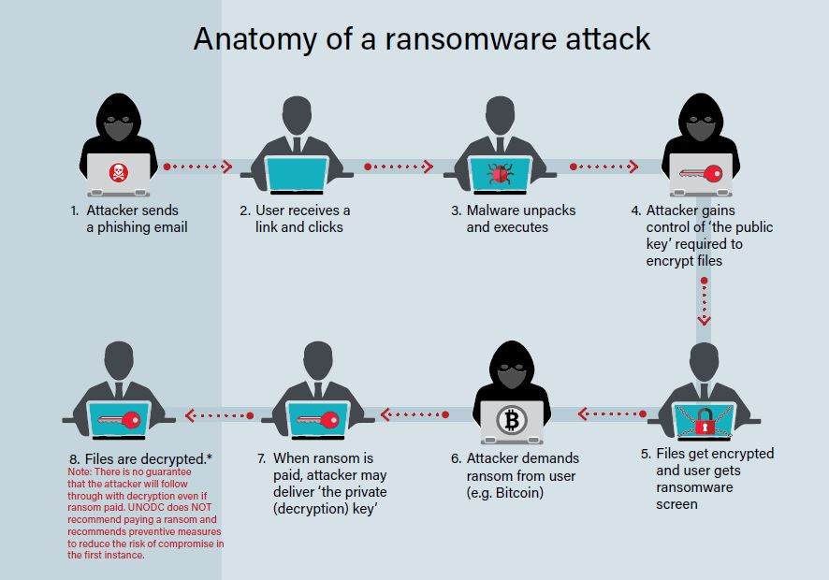
Ransomware

Slide 19

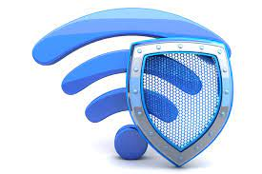
Wifi Security
Internet users are widely using Wi-Fi devices to access Internet. Every year millions of Wi-Fi devices are sold in the market. Out of these most of the wireless devices are vulnerable in their default configuration mode.
Anyone with Wi-Fi connectivity in his computer, laptop or mobile can connect to unsecured Access Points(wireless routers).Anyone in the range of Access point can connect to an Access Point if it is unsecured. Once the connection is established the attacker can send mails, download classified/confidential stuff, initiate attack on other computers in the network, send malicious code to others, install a Trojan or botnet on the victims computer to get long term control on it through Internet, etc.

Slide 20
Chapter 4

Slide 21
Types of Attacks on Wireless Environment
Denial of Service Attack
Denial of Service Attack aims at preventing the users from accessing the network resources. In a Wireless network, denial of service attack can be applied in various ways.
Man-In-Middle Attack in Wi-Fi Devices
Performing Man-In-Middle Attack in a wireless network is much easier, when compared to wired network. As the transmissions from an access point is broadcasted, it is easy for an unauthorised user to collect the traffic sent by other wireless clients. And the process of collecting the packets in this manner is known as Eavesdropping. Also the third party user can manipulate the packets sent to the legitimate users which results in breaking the users privacy. So In order to avoid these kind of attacks, Strong encryption should be used for transmitting the data between wireless client and access point.
WarDriving
It is a process of tracking Wi-Fi hotspots located at a particular place, while moving with a hand held device or a laptop in a vehicle. This helps the user in finding out the access points that does not use encryption and takes control over it for performing the attacks on the network

Slide 22

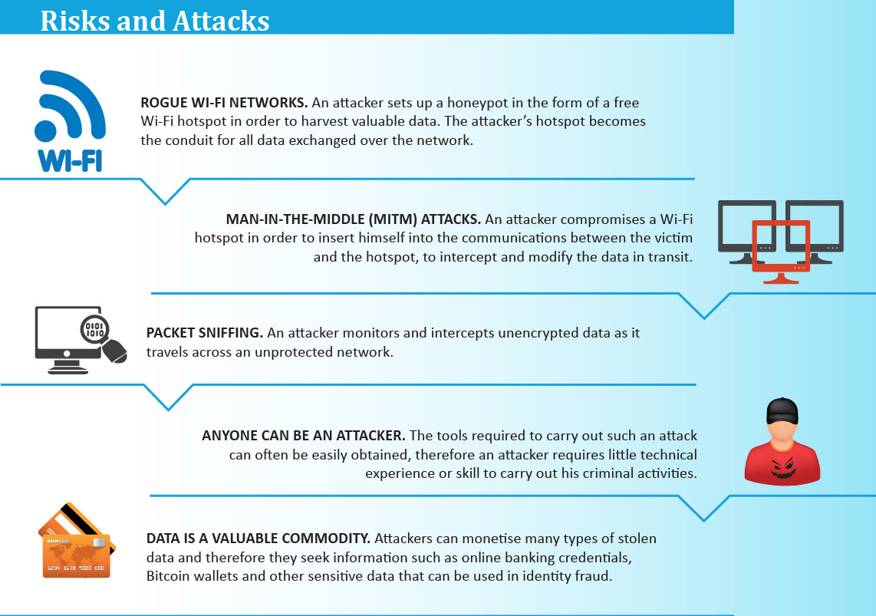
Guidelines for securing Wireless Communications
Always use strong password for encryption:
Always use the maximum key size supported by access point for encryption
Isolate the wireless network from wired network with a firewall and a antivirus gateway.
Restrict access to the Access Point based on MAC address
Change the default username and Password of the Access Point
Shutdown the Access Point when not in use
Do not broadcast your network name
Always maintain a updated firmware
Use VPN or IPSEC for protecting communication
Do not make the SSID information public

Slide 23
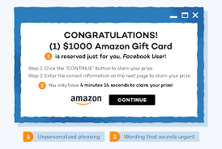

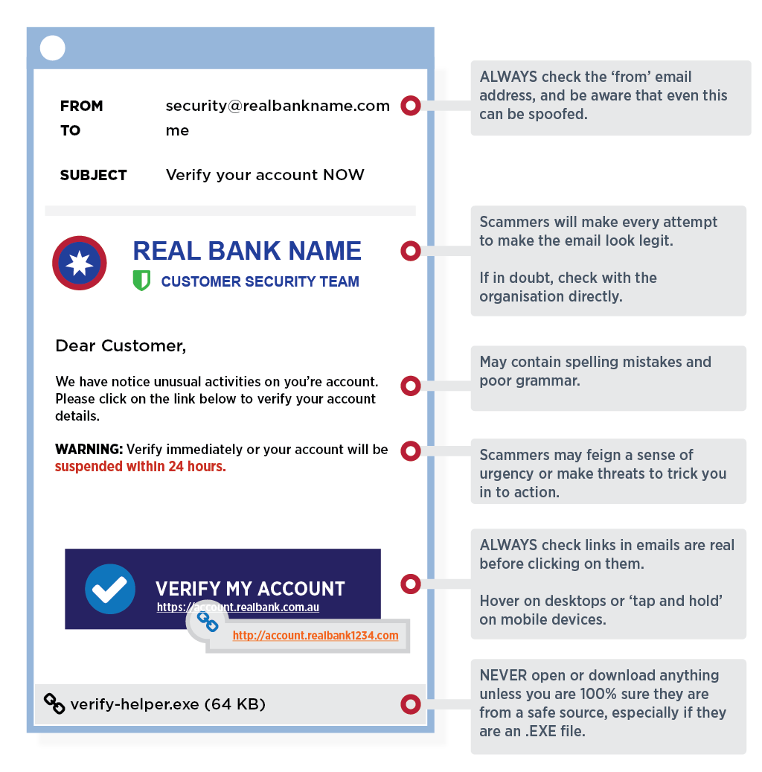
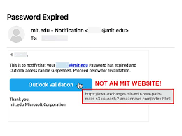
Email/Lottery Scams
Lottery scam
Sometimes you receive an email like “you won a lottery of million dollars” receiving such a kind of mails is a great thing, and really it’s a happiest thing. By responding to such a kind of mails huge amount of money will be lost. Because these e-Mails are not true, scammers try to fool and trap you to obtain money.
Email Scam Like -Congratulations you have won Webcam, Digital Camera, etc.
Sometimes you get an e-mail with a message like - you have won something special like digital camera web cam , all you need to do is just visit our web site by clicking the link given below and provide your debit or credit card details to cover shipping and managing costs. However the item never arrives but after some days the charges will be shown on your bank account , and you will lose money.

Slide 24
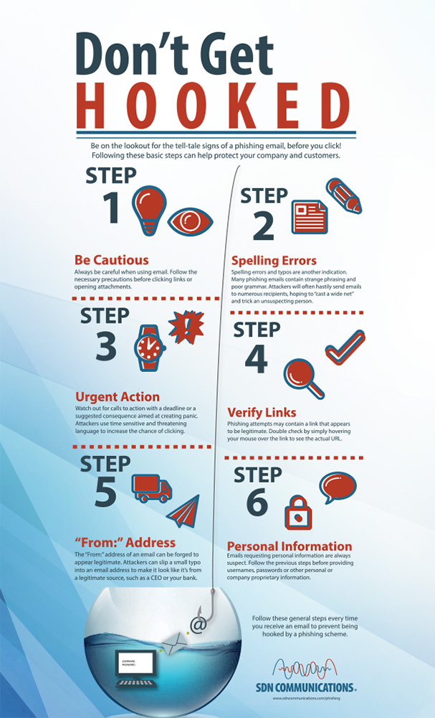

Precautions
Never respond to e-mail or SMS on mobile from strangers regarding online lottery or bumper festival bonanza.
Don't deposit any money in unknown accounts without proper confirmation.
The winning lottery amount is a fraud committed with convenience of a bank account holder who is paid commission and has no link with fraudster.
Don’t get trapped by scammers and e-Mails with a subject line you won some $10000 just think why only you received the email without your participation.
Be aware about the products you get for a discounted price. Think why you received email for products when you never enter any online shopping or contest.

Slide 25

Desktop Security
The growing reach of the Internet and the rapid spread of information through mobile devices have presented new opportunities that could put some women at risk, so it is important to be mindful of the dangers.
A personal computer used without proper security measure could lead to exploiting the system for illegal activities using the resources of such in secured computers. These exploiters could be Virus, Trojans, Key loggers and sometimes real hackers. This may result in data theft, data loss, personal information disclosure, stealing of credentials like passwords etc. So, protect and secure your Personal Computer before it is compromised.
Things to remember ….while using your personal computer!
Don’t leave your webcam connected
Scan external devices before Use
Backup your data
Control Access to your personal computer
Use Licensed Software
Update all operating systems on you devices

Slide 26
Chapter 5

Slide 27
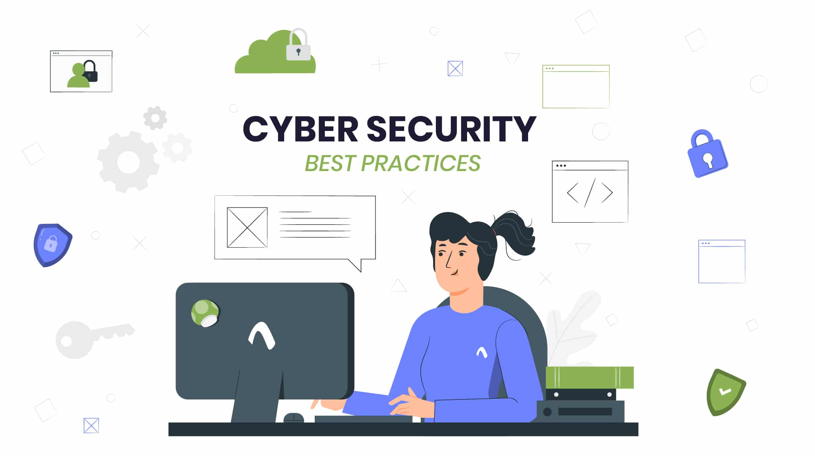
Best Practices to follow
Don’t be lazy with your passwords!
Disable Bluetooth when you don’t need it
Enable 2-Factor Authentication
Remove adware from your machines
Double check for HTTPS on websites
Keep software up-to-date
Avoid opening suspicious emails
Keep hardware up-to-date
Use a secure file-sharing solution
Use anti-virus and anti-malware

Slide 28
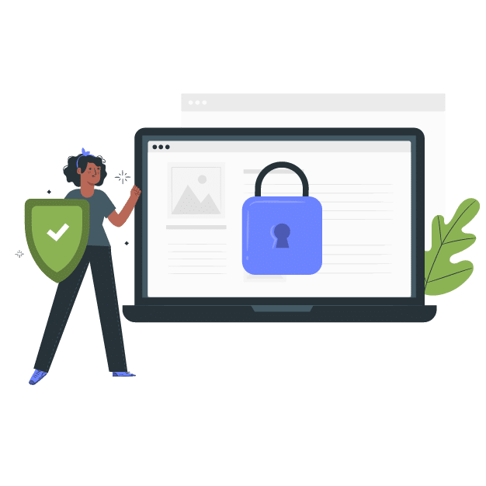
Best Practices to follow
Don’t store important information in non-secure places
Scan external storage devices for viruses
Use a VPN to privatize your connections
Check links before you click
Avoid using public networks

Slide 29
Do's and Don'ts to keep system secure
DO’S
Create strong passwords that are at least eight characters long, and including at least a numerical value and a symbol, such as #, to foil password-cracking software.
Avoid common words, and never disclose a password online.
Change your password every ninety days.
Perform regular backups of important data.
Create a password for your files in order to protect file sharing activities.
Download and install software only from online sources you trust.
Never click on a link from an untrusted source.
Close windows containing pop-up ads or unexpected warnings by clicking on the “X” button in the upper most right-hand corner of that window, not by clicking within the window.
Use antivirus software and update it on a regular basis to recognize the latest threats. Heed
ITR security alerts to download antidotes for newly circulating viruses and worms.
Regularly update your operating system, Web browser, and other major software, using the manufacturers' update features, preferably using the auto update functionality.
Set Windows or Mac updates to auto-download.

Slide 30
Don'ts
Never write down your password. Especially on a Post-It note stuck to your computer!
Never give out your password to anyone, whether you know them or not.
Never select the "Remember My Password" option. Many applications do not store themsecurely.
Never purchase anything promoted in a spam message. Even if the offer isn’t a scam, you are only helping to finance and encourage spam.
Please refrain from opening an e-mail attachment, even from someone you know well, unlessyou were expecting it.
Avoid creating common passwords such as your name, social security, UNI, etcetera.
Do not leave your laptop unattended, even for a few minutes.
Never reply to e-mail(s) requesting financial or personal information.
Avoid opening e-mail(s) or e-mail attachments from an unknown sender.
Please refrain from clicking on the close button within pop-up ads.
Under no circumstances should you install or use pirated copies of software.
Do not install P2P file sharing programs which can illegally download copyrighted material.
Never set your e-mail program to "auto-open" attachments.

Slide 31
Chapter 6

Slide 32
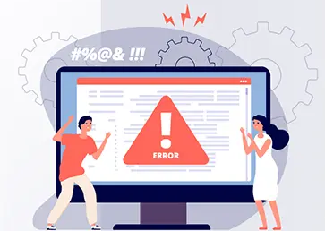
What is Incident Response Management?
Incident Response Management (IRM) is a structured approach to addressing and managing the aftermath of a security incident. The primary goal of incident response is to contain the damage, eradicate the threat, recover normal operations, and learn from the incident to prevent future occurrences.

Slide 33
Phases of Incident Response Management
The incident response management process typically consists of several distinct phases. These phases are often represented as a continuous cycle, emphasizing the importance of learning from each incident to improve the organization's overall security posture. The phases are as follows:
Preparation: Establishing and training an incident response team. Developing and maintaining an incident response plan.
Identification: Use monitoring tools, intrusion detection systems and log analysis to recognize abnormal activities.
Containment: Isolate affected systems to prevent further damage.
Eradication: Identify and eliminate the root cause of the incident. Apply permanent solutions to remove vulnerabilities and prevent similar incidents. Ensure that the system is secure and free from any traces of the incident.
Recovery: Restore systems and services to normal operation. Validate the integrity of restored systems. Communicate with stakeholders and users about the resolution and any necessary actions.
Lessons Learned: Conduct a post-incident analysis to understand the incident's causes and effects. Document lessons learned and update incident response plans and security policies.
Documentation: Maintain detailed records of the incident, including timelines, actions taken, and outcomes. Ensure that all relevant information is documented for regulatory compliance and future reference. Document any changes made to systems during the incident response process.
Communication: Establish clear communication channels within the incident response team. Communicate with external parties, such as management, legal, and law enforcement if necessary.

Slide 34

What is the role of Incident Response Manager?
The Incident Response Manager plays a crucial role in overseeing and coordinating the activities of the incident response team during a security incident. Their responsibilities include:
Planning and Preparedness: Conduct regular training and simulation exercises to ensure the team is well-prepared for potential incidents.
Team Coordination: Leading the incident response team during an actual security incident.
Incident Identification and Assessment: Oversee the process of identifying and assessing security incidents. Classify incidents based on severity and potential impact.
Containment and Eradication: Lead the efforts to contain the incident, isolate affected systems, and prevent further damage. Guide the team in identifying and eliminating the root cause of the incident.
Communication: Serve as the primary point of contact for communication with internal and external stakeholders.
Recovery: Ensure that recovery efforts are conducted efficiently and effectively.
Post-Incident Analysis and Documentation: Conduct a thorough post-incident analysis to understand the causes and impacts of the incident.
Continuous Improvement: Lead efforts to continuously improve the organization's incident response capabilities.

Slide 35
Chapter 7

Slide 36
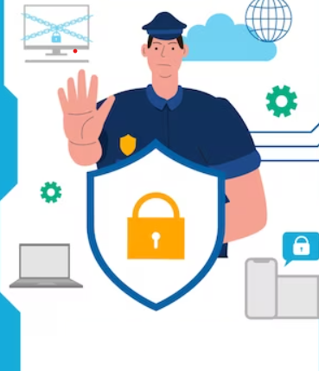
What do you mean by Data Protection?
Data protection refers to the practices, measures, and policies implemented to safeguard sensitive information from unauthorized access, disclosure, alteration, and destruction.
The primary goal of data protection is to ensure the confidentiality, integrity, and availability of data, thereby safeguarding the privacy and rights of individuals and organizations.

Slide 37
Data Protection Measures
Implement strong access controls to ensure that only authorized individuals have access to sensitive data.
Use role-based access control (RBAC) to assign permissions based on job roles and responsibilities.
Encrypt sensitive data both in transit and at rest to protect it from unauthorized access.
Perform regular backups of critical data to ensure its availability in the event of data loss, corruption, or a ransomware attack.
Store backups in a secure and separate location, disconnected from the primary network.
Classify data based on its sensitivity and importance to the organization.
Provide regular training to employees to raise awareness about data protection best practices.
Educate users about the risks of phishing, social engineering, and other common tactics used by attackers to gain unauthorized access to data.
Implement security measures on endpoints (computers, laptops, mobile devices) to protect against malware, ransomware, and other threats.
Use endpoint protection software, firewalls, and regularly update and patch operating systems and software.
Employ firewalls, intrusion detection and prevention systems, and other network security tools to monitor and control traffic.
Establish a clear and defined process for responding to and mitigating security incidents.
Develop and enforce data privacy policies that align with relevant regulations and standards.
Implement physical security measures to protect data storage facilities, data centers, and other locations where sensitive information is stored.
Conduct regular security audits and assessments to identify vulnerabilities and weaknesses in the organization's data protection measures.

Slide 38

Attack Surfaces which Hackers generally Target
Networks: Exploiting vulnerabilities in network protocols and services to gain unauthorized access. Conducting network-based attacks, such as man-in-the-middle attacks and packet sniffing.
Web Applications: Exploiting vulnerabilities in web applications, such as SQL injection, cross-site scripting (XSS), etc. Attacking web servers to gain control over hosted applications and databases.
Endpoints: Exploiting vulnerabilities in operating systems and software applications on endpoints.
Emails: Conducting phishing attacks through email to trick users into disclosing sensitive information or downloading malicious attachments. Exploiting vulnerabilities in email systems to gain unauthorized access.
Cloud Services: Exploiting misconfigurations or vulnerabilities in cloud infrastructure and services.
Social Engineering: Manipulating individuals through psychological tactics to trick them into divulging confidential information, such as passwords or login credentials.
Physical Security: Conducting physical attacks, such as unauthorized access to data centers or stealing hardware devices. Exploiting weaknesses in physical security measures, such as access controls and surveillance systems.
IoT Devices: Exploiting vulnerabilities in Internet of Things (IoT) devices to gain control over connected systems.
Wireless Networks: Exploiting vulnerabilities in wireless network protocols, to gain unauthorized access to the Wi-Fi Network.

Slide 39
What are the tools and technologies used to protect IT Infra and Applications from cyber criminals?
Firewalls: To monitor and control incoming and outgoing network traffic based on predetermined security rules. Example Tools: Cisco ASA, Palo Alto Networks, pfSense.
Intrusion Detection & Prevention Systems: To detect and prevent unauthorized access or suspicious activities in networks. Example Tools: Snort (IDS), Suricata (IDS/IPS), Cisco Firepower.
Antivirus: To detect, prevent, and remove malicious software (viruses, worms, Trojans) from systems. Example Tools: Symantec, McAfee, Windows Defender.
Endpoint Protection: To secure individual devices and endpoints from cyber threats. Example Tools: CrowdStrike, Microsoft Defender for Endpoint, Cylance.
Virtual Private Network (VPN): To establish secure and encrypted connections over the internet, ensuring confidentiality and privacy. Example Tools: OpenVPN, Cisco AnyConnect, NordVPN.
Security Information & Event Management (SIEM): To collect, analyze, and correlate log data from various sources to identify and respond to security events. Example Tools: Splunk, IBM QRadar, LogRhythm.
Data Loss Prevention (DLP): To prevent unauthorized access and transmission of sensitive data. Example Tools: Symantec DLP, McAfee DLP, Digital Guardian.
Web Application Firewall (WAF): To protect web applications from various attacks, such as SQL injection and cross-site scripting (XSS). Example Tools: ModSecurity, Barracuda WAF, F5 Networks.
Vulnerability Scanning & Management: To identify and remediate vulnerabilities in systems and applications. Example Tools: Nessus, Qualys, Rapid7 Nexpose.

Slide 40
DNS Attacks

Slide 41
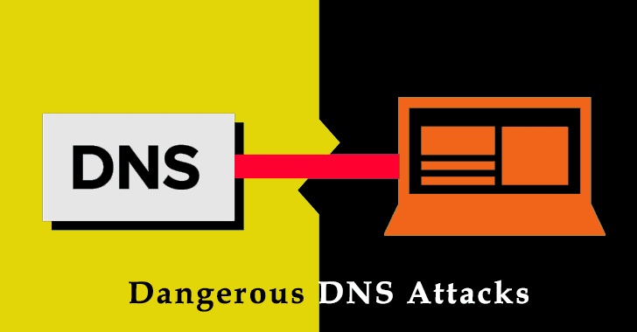
What is DNS? What are the types of DNS attacks?
DNS (Domain Name System) is a critical component of the internet infrastructure, translating human-readable domain names into IP addresses. Various types of DNS attacks exploit vulnerabilities in the DNS to compromise network integrity, disrupt services, or redirect traffic. Here are common types of DNS attacks:
DNS Spoofing: Attackers provide false DNS responses to redirect users to malicious websites. This is often achieved by injecting false DNS records into the cache of a DNS resolver.
DNS Amplification Attack: Exploiting DNS servers to amplify the size of a DDoS attack. Attackers send small DNS
queries with a spoofed source IP address, and the server responds to the target with a much larger response.
DNS Tunneling: Encapsulating non-DNS traffic within DNS requests and responses to bypass security measures
and exfiltrate data.
DNSSEC (DNS Security Extensions) Zone Walking: Exploiting weaknesses in DNSSEC to obtain a list of all resource records in a DNS zone, potentially aiding attackers in reconnaissance.
Distributed Denial of Service (DDoS) Attack on DNS Infrastructure: Overwhelming DNS servers or infrastructure with a high volume of traffic to disrupt DNS resolution services.
DNS Hijacking: Unauthorized changes to the registration of a domain, diverting traffic from legitimate servers to malicious ones.
NXDomain Attacks: Forging DNS responses to indicate that a domain does not exist (NXDOMAIN), causing recursive DNS resolvers to repeatedly query for the non-existent domain.
Fast Flux DNS: Frequently changing the IP addresses associated with a domain to make it challenging for security systems to track and block malicious activity.
Random Subdomain Attacks: Creating a large number of random subdomains to overwhelm DNS resolvers and evade security measures.

Slide 42
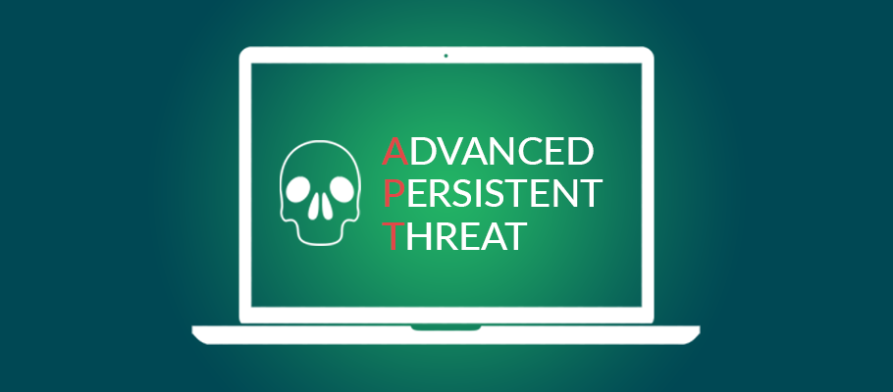
What do you mean by APT? What are the types of APT attacks?
An Advanced Persistent Threat (APT) is a sophisticated and targeted cyber attack in which an unauthorized person gains access to a network and remains undetected for an extended period. APT attacks are typically well-planned, persistent, and often state-sponsored. Different types of APT attacks exist, each with its own characteristics and methodologies. Here are some common types of APT attacks:
Spear Phishing: Targeted and highly personalized phishing attacks that are tailored to specific
individuals or organizations.
Watering Hole Attack: Targeting websites frequented by a specific group of users to infect
their systems with malware.
Zero-Day Exploits: Exploiting software vulnerabilities that are unknown to the software vendor or the public.
Drive-By Downloads: Malicious software is automatically downloaded and installed on a user's device without their knowledge or consent.
Malware Deployment: Infiltrating a network with malware to gain control over systems and exfiltrate sensitive information.
Credential Theft: Stealing login credentials, such as usernames and passwords, to gain unauthorized access.
Lateral Movement: Moving laterally within a network to gain access to different systems and escalate privileges.
Data Exfiltration: Illegally transferring sensitive data from a compromised network to an external location controlled by the attacker.
Command & Control Servers: Establishing communication channels between compromised systems and external servers controlled by the attacker.

Slide 43

What do you mean by SQL Injection?
SQL injection is a type of cyber attack where an attacker inserts malicious SQL (Structured Query Language) code into the input fields to manipulate a database. This can allow unauthorized access, retrieval, modification or deletion of data.
To prevent SQL injection, its crucial to use parameterized queries or prepared statements and validate user inputs.

Slide 44


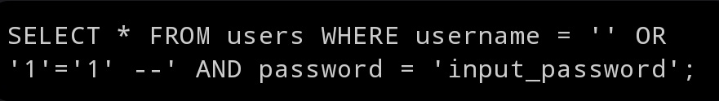
How attackers exploit web applications using SQL Injection.
SQL injection attacks exploit vulnerabilities in web applications that improperly handle user-supplied input. Attackers inject malicious SQL code into the input fields or other user-controllable areas.
Suppose a web application constructs a SQL query like this to authenticate a user:
If attacker inputs the following into the username field:
The resulting query becomes:
The double hyphen (--) signifies a comment in SQL, making the rest of the query effectively ignored. The condition ‘1’ = ‘1’ always evaluates to true, allowing the attacker to bypass authentication.

Slide 45
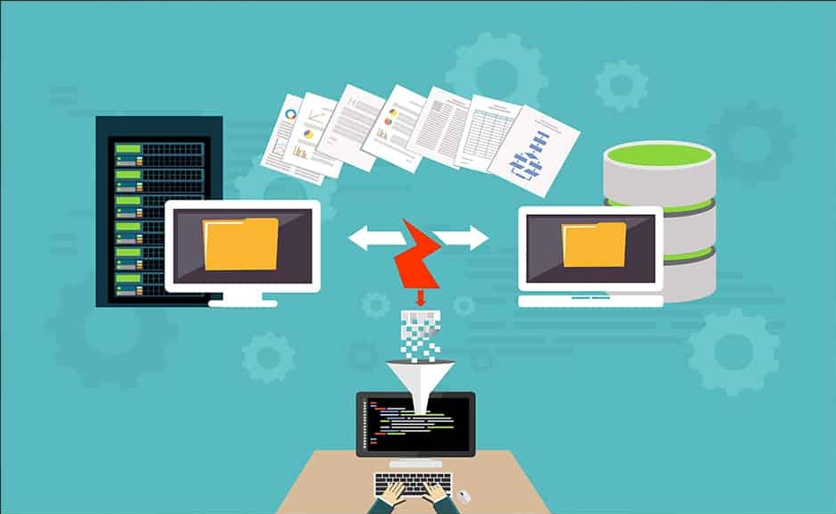
What is Man-in-the-Middle Attack?
A Man-in-the-Middle attack is a security breach where an attacker intercepts and possibly alters the communication between two parties without their knowledge.
The attacker positions themselves between the communicating entities allowing them to eavesdrop on or manipulate the data being exchanged.
Types of MITM attacks include Packet Sniffing, Session Hijacking, SSL Stripping, etc.
To mitigate MITM attacks, its essential to use encrypted communication protocol (HTTPS), implementing secure Wi-Fi connections, using public key infrastructure (PKI) for authentication.

Slide 46
Cyber Stalking

Slide 47
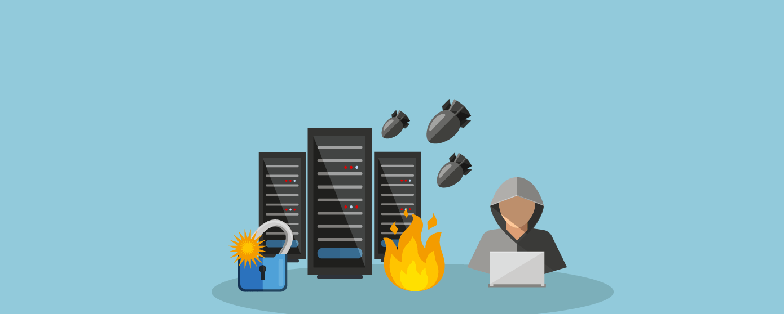
What is Distributed Denial of Service Attack?
A Distributed Denial of Service attack is a malicious attempt to disrupt the regular functioning of a network, service or a website by overwhelming it with a flood of internet traffic.
Unlike traditional DOS attack where a single source is used to flood the target, a DDOS attack involves multiple compromised computers forming a botnet.
Botnet: Attackers often control a network of compromised computers to launch the attack.
Mitigation: deploying DDOS protection services, firewalls, load balancers and content delivery networks (CDNs) to defend against these attacks.

Slide 48
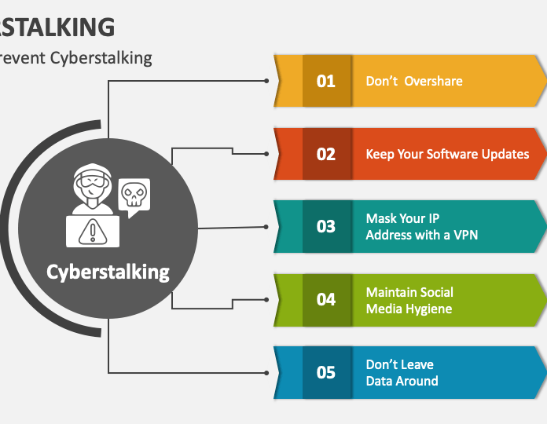
What is Cyberstalking?
Cyberstalking is a crime committed when someone uses the internet and other technologies to harass or stalk another person online.
Even though cyberstalking is a broad term for online harassment, it can include defamation, false accusations, teasing, and even extreme threats.

Slide 49

What is Cyberbullying?
Cyberbullying is the use of technology to harass, threaten, embarrass, or target another person. Online threats and mean, aggressive, or rude texts, tweets, posts, or messages all count.

Slide 50
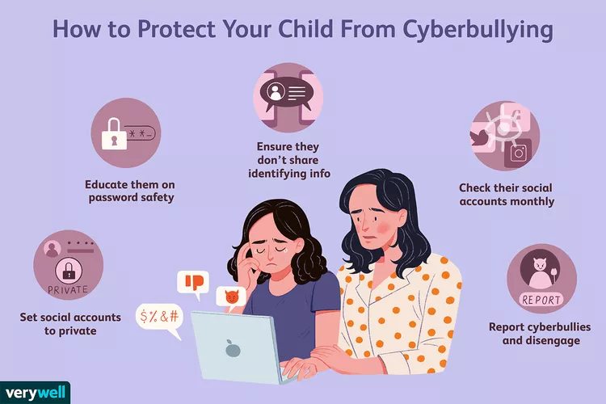
How to prevent Cyberstalking/Cyberbullying?

Slide 51
Chapter 10

Slide 52


Slide 53


